Slide 1
MES Project
Volume control using an ultrasonic sensor
Author: Andronic Smaranda
Master’s Program: ACES

Slide 2
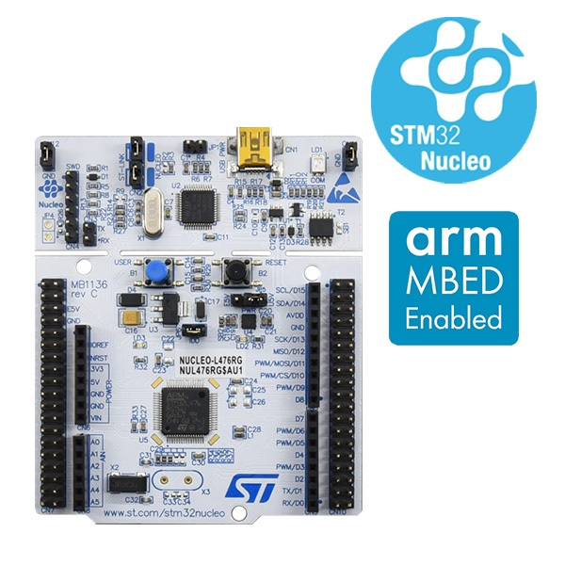
PROJECT DESCRIPTION
This project aims to understand low-level programming on an ARM-based STM32 microcontroller by working directly with registers, timers, GPIOs, and interrupts.
As a practical example, an ultrasonic alarm system was implemented using an HC-SR04 sensor and a buzzer, where the alarm behaviour changes based on the detected distance.

Slide 3
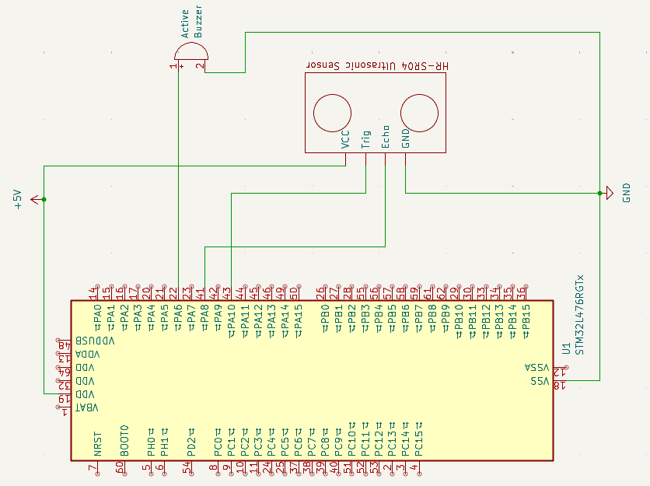
Hardware setup
Components used:
Microcontroller: STM32L476 Nucleo development board
Ultrasonic distance sensor: HC-SR04
Buzzer : Piezoelectric active buzzer

Slide 4
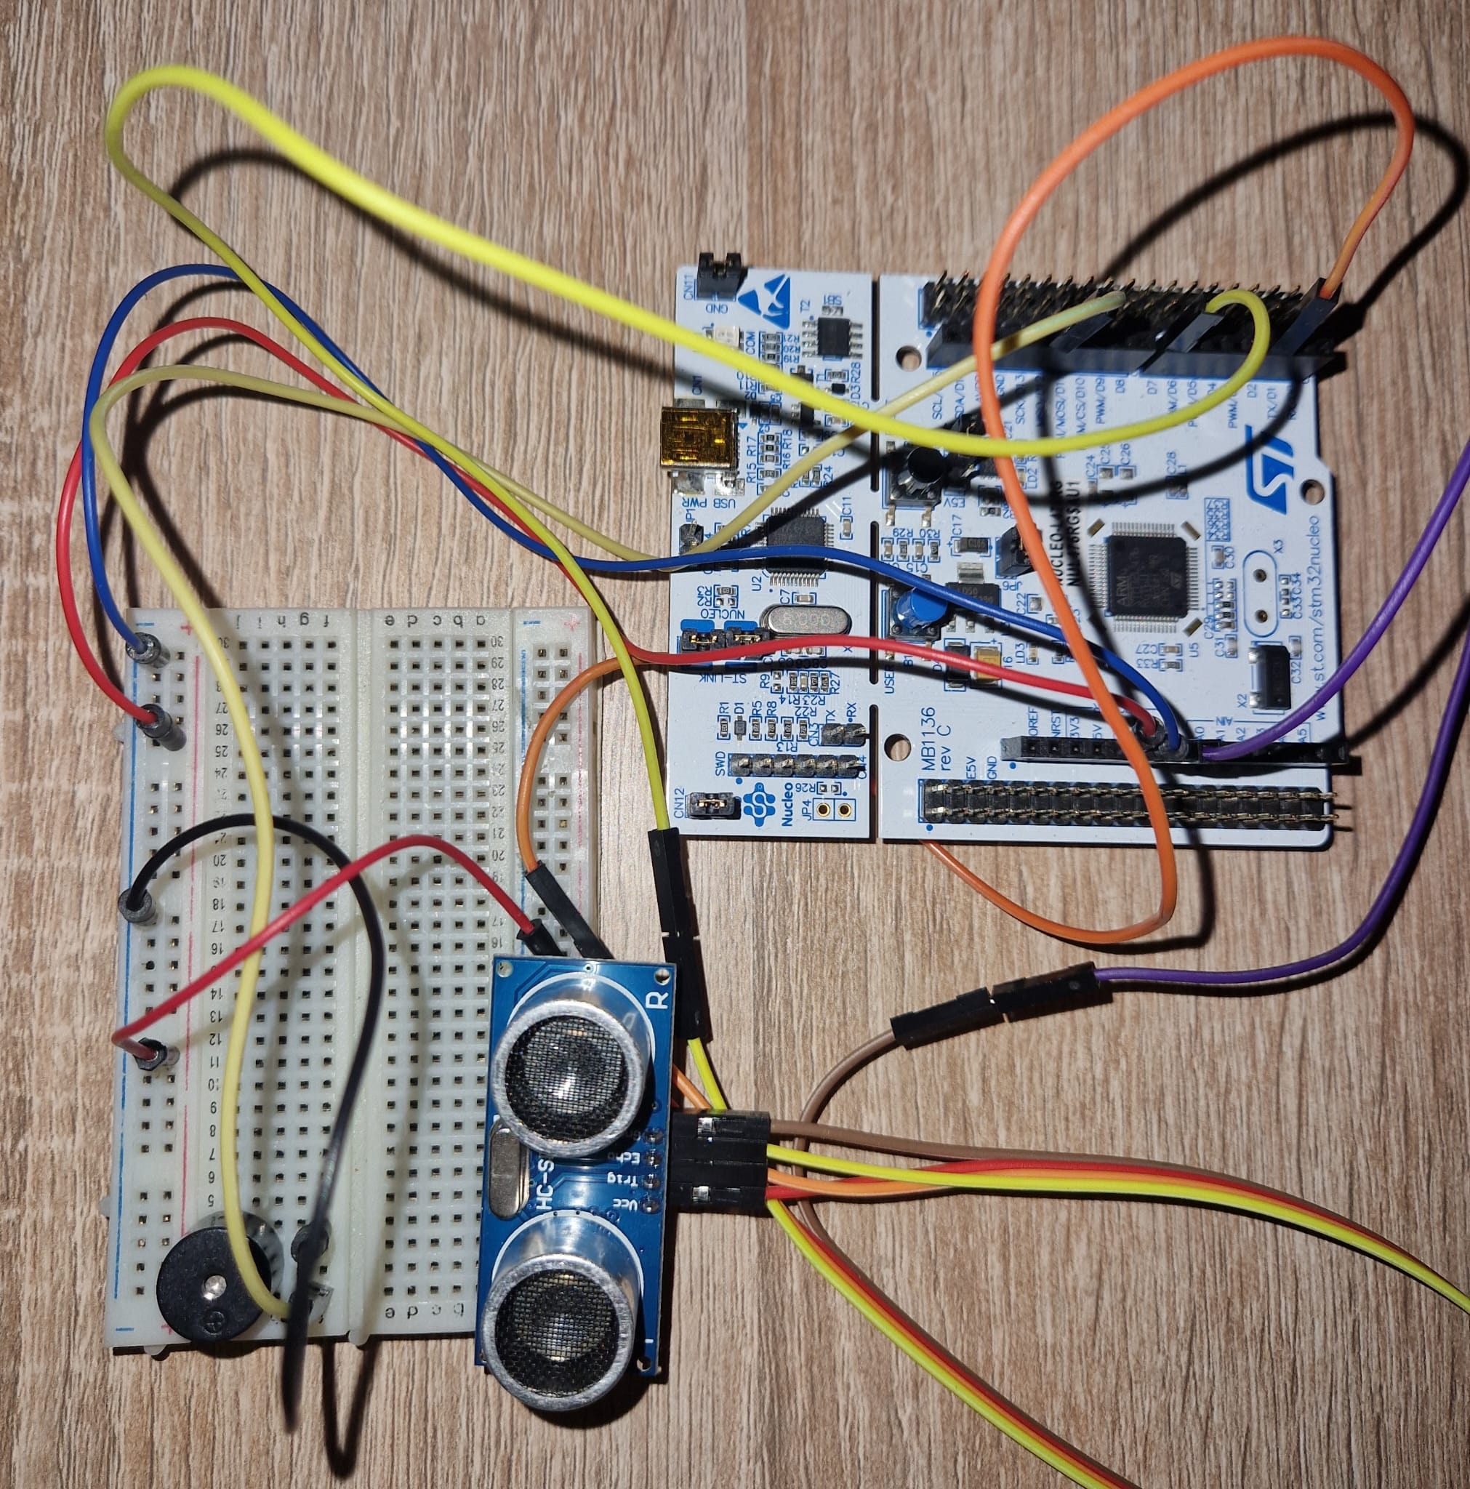
STM32L476 Nucleo development board
Piezoelectric buzzer
Ultrasonic sensor

Slide 5
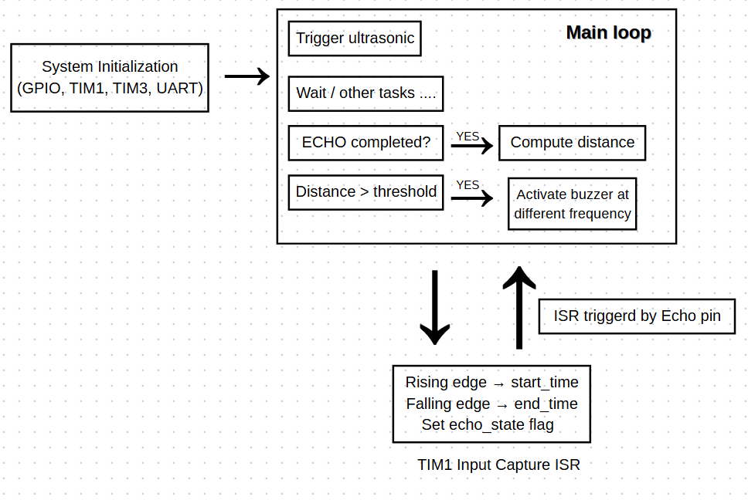
Software Pipeline
Timer interrupts are triggered by hardware events on the ultrasonic sensor’s echo pin and are used to capture precise timing information without blocking the main program flow.

Slide 6
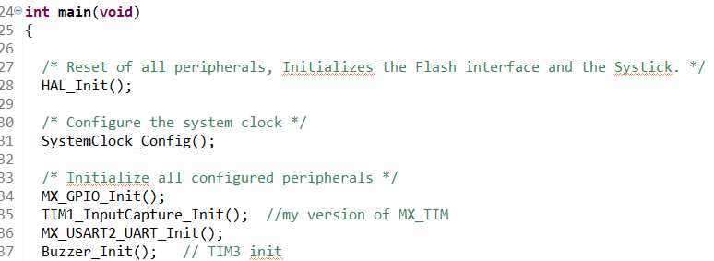
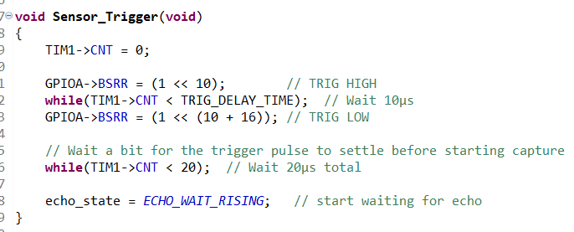
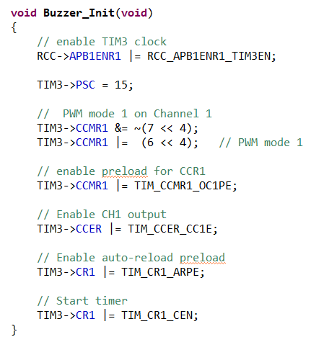
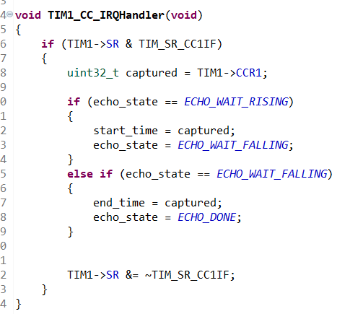
Custom functions.
Not using HAL for configuring timers
Sensor_Trigger() sends a precise 10 µs trigger pulse to the ultrasonic sensor, resets the timer, and prepares the system to measure the echo pulse using timer interrupts.
This function configures Timer 3 (TIM3) at register level to generate a PWM signal used to drive the active buzzer on PA6 (TIM3_CH1).
The echo pin is connected to TIM1 in input capture mode, which generates interrupts on both the rising and falling edges of the echo signal

